Slide 1
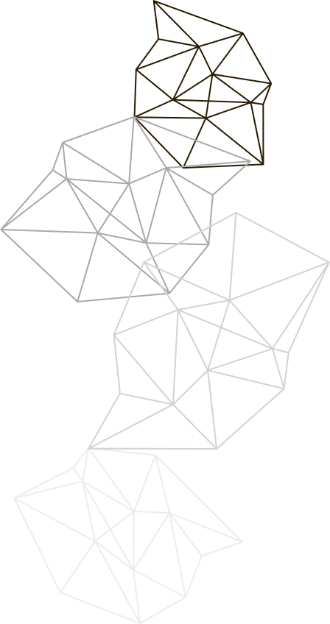
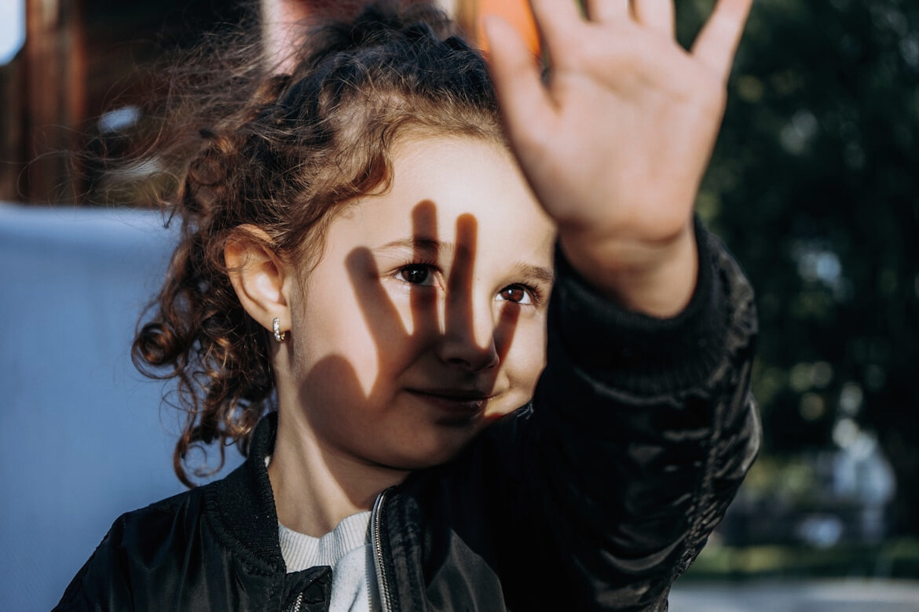
Realtime UV Monitoring
and
Alert System
Team Aurora
University of Ruhuna

Slide 2

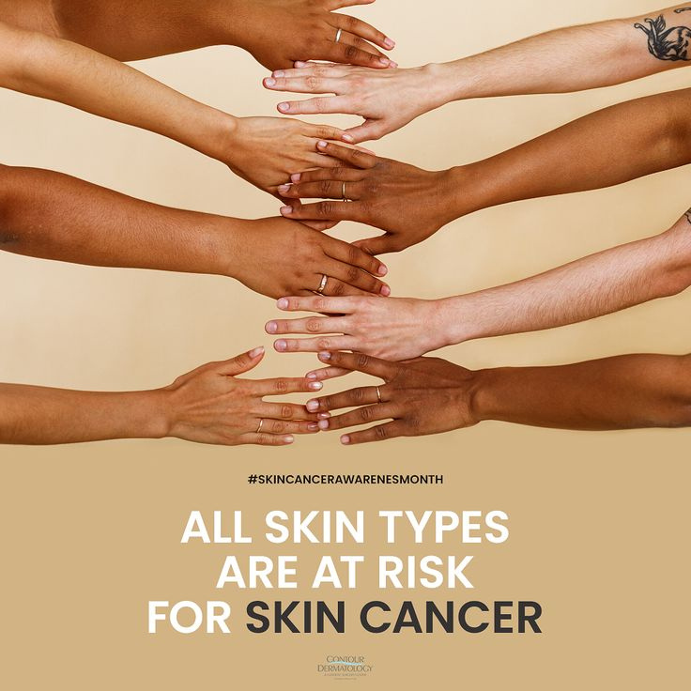

How SunSmart Are You?
1.5M
120k
Skin cancers diagnosed
Skin cancer associated deaths
15M
Blind due to cataracts

Slide 3
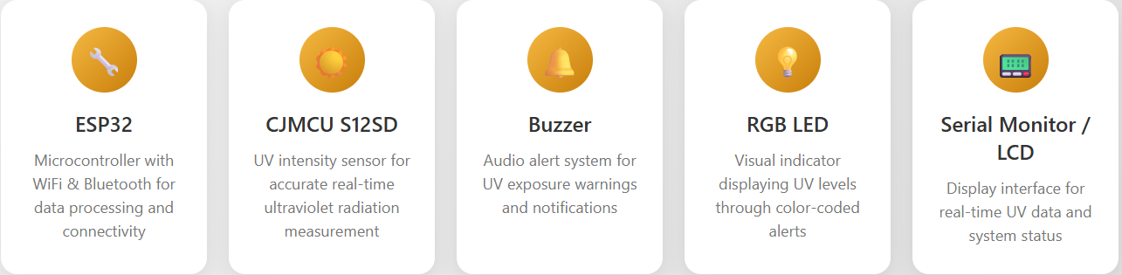
Our Solution
Target Audience
Health conscious individuals, Tourists, Travelers, Outdoor workers
Feature
Real-time UV monitoring
Visual indication & audio alert
Low cost portable design

Slide 4
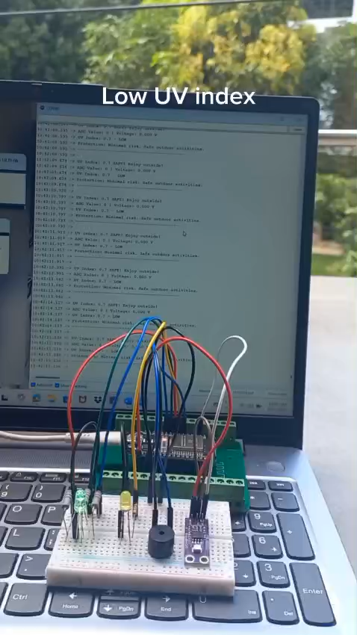
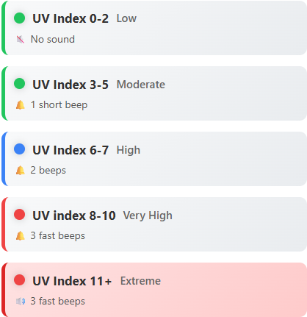
Working and Demo

Slide 5


Future Scope
01
Wearable version (bracelet/watch)
02
Mobile app with data logging
03
Cloud-based data logging for long-term analysis
04
Solar-powered design

